Slide 1
Monon K-5 Painting & Lettering Guide
Page 1
Eric Bott
(314) 757-3609

Slide 2
General Description of Project
Page 2
Paint, letter & finish one OMI Monon Steam Locomotive, road number 440
Almost entire engine black, except:
Smoke box, smoke stack, firebox below the running boards: Mix of 75% Light Graphite with 25% Medium Graphite
Headlamp, front handrail, marker lamps, piping, steam delivery pipes, and other attachments to smokebox and firebox: Black
Running board edges: White (use provided decal striping or paint as you prefer)
Stack cap, cylinder and front valve heads: “Chrome” paint
Bell, whistle, pops, builder’s plates: Brass
Cab interior walls: Light Green
Arm rests, cab floor: Medium Brown
Cab Gauges and all control knobs/handles: red or white, as appropriate
Glad hands: Silver or aluminum
Do NOT paint rods, valve gear, or tires
Finish is to be just on the semi-gloss side of satin (match Glacier Park Models’ (Boo Rim’s) finish as closely as possible.) NO weathering; an as-shopped appearance is desired.
Decals: Custom set provided
Finish to include:
Cab glazing
Coal load
Marker jewels (white all around)
Headlamp and tender lamp lenses
Install dual mode DC/DCC sound decoder, install speaker
Connectorize cable between loco and loco tender
Add headlamp, tender lamp (on loco tender), cab interior lamp, all under DCC control

Slide 3
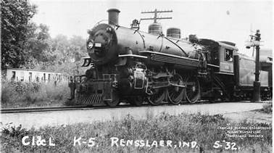
Lettering; Road Number to be 440
Page 3
We’re going to keep the running board edge stripes (sides and front of all running boards, but not the dome, cylinder jacket, cab, or tender striping, shown in this photo.

Slide 4
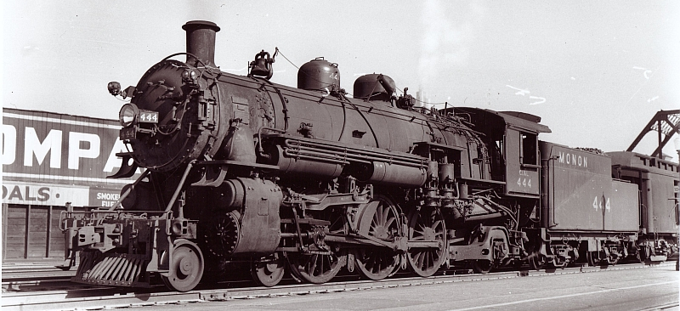
Lettering; Road Number to be 440
Page 4
This is a K-5a, nearly identical to the K-5’s.
Mask off and do not paint builder’s plates.
Road number on cab side and sand dome in funky Monon font.
“C.I.&L.
440
K-5”
Center the large “MONON” lettering on tender where “444” is in this photo. Delete “MONON” on coal bunker extension. See Page 6.
Road number in white stencil font on headlamp sides, brass roman font on front number board.

Slide 5
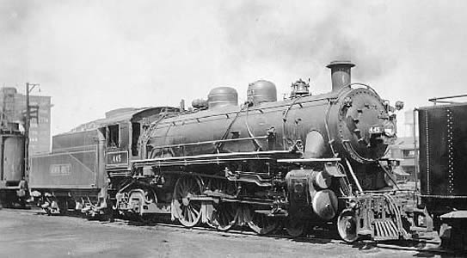
Lettering (All white); Road Number to be 440
Page 5
This is also a K-5a, nearly identical to the K-5’s. Note running board stripes and chromed cylinder and valve heads.
Evidence that at least some of the K-5 and K-5a had chromed cylinder heads.

Slide 6
Tender Lettering; Road Number to be 440
Page 5
This is NOT a K-5, but this is the way I want the tender done.
Center the “440” of
“7000 GALS
15 TONS
440”
on tender back, behind the ladder. The “7000 GALS” should be about 1/16” below the top edge of the tender back.
Center “MONON” on tender as shown in this photo.

