Slide 1
Boston & Albany J-2b Painting & Lettering Guide
Eric Bott
(314) 757-3609

Slide 2
General Description of Project
Page 2
Paint, letter & finish one Key B&A J-2b loco, road number 609
Boiler jacket above the running boards, cylinder jackets: Olive Green (match models shown in Pages 5-10 as closely as possible-- (to me the GN Olive Green looks closer than the D&RGW Olive Green, but even the GN green looks a bit dark. Record mixture, and save for B&A D-1a project.)
Cab sides (up to the drip rail), cab back, tender sides and back: Pullman Green (match models shown in Pages 5-11 as closely as possible. Record mixture, and save for B&A D-1a project.)
Smokebox cylinder, smokestack, ash pans: mix 50% Medium Graphite with 50% light graphite (please try for a close match to models shown in Pages 5-10)
Smokebox front: Light Graphite
Headlamp, marker lights, bell mounting bracket and hanger, all piping and handrails on loco and tender, throttle linkage and cranks, boiler check valve and supply line, running board surfaces, air reservoirs, generator, steam supply pipes, cylinder front and back, pilot and HW mounted on pilot, frame, valve gear (hanger only), cab roof down to the drip rail, cab deck, pilot and trailing truck, backhead, cab front panel, boiler jacket below the running boards, firebox (except ash pans) below the running boards, all wheel centers, tender underbody & trucks, tender deck and back of coal bunker, coal bunker interior, tender frame side-rails and end beams, tender ladders and steps, tender deck and coal doors, tender back-up lamp: Black
Bell, whistle, pop valves, builder’s plates on smokebox: Natural Brass
Cab interior walls: Light Green
Cab arm rests and seat cushions: Dark Brown
Glad hands, reversing bar between power reverser and valve gear: Silver or Chrome
Cab gauges and controls: White or red, as appropriate
Running board edges, cab bottom edges: Silver (paint or decal OK for running board and cab stripes)
Do NOT paint valve or running gear
Finish is to be just on the semi-gloss side of satin (match Glacier Park Models’ (Boo Rim’s) finish as closely as possible.) NO weathering; an as-shopped appearance is desired.
Decals: Custom set provided
Finish to include:
Cab glazing
Marker jewels (white all around)
Headlamp and tender lamp lenses
Coal Load
Clear coat
Install dual mode DC/DCC sound decoder, install speaker
Add headlamp, tender lamp, cab interior lamp, all under DCC control

Slide 3
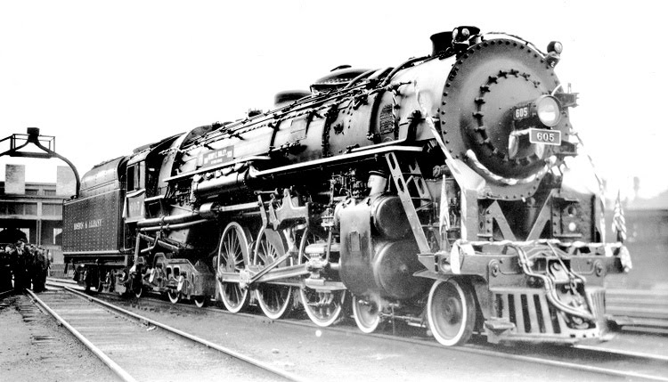
B&A J-2b, road number to be 609
Prototype photo showing the running board striping and tender lettering and striping. The J-2b’s were delivered in a striking olive green/Pullman green/black scheme with silver lettering.
This particular loco was apparently painted with scarlet boiler and cylinder jackets, and given gold lettering, for a few days to commemorate the retirement of a long-serving B&A engineer. Maybe we’ll do that scheme one day, if I can find another Key model! Note that the upper tender stripe is narrower than the lower tender stripe.

Slide 4
B&A J-2b, road number to be 609
Prototype photo showing the very light graphite front to the smokebox. Note the black handrail.

Slide 5
B&A J-2b, road number to be 609
A gorgeously custom painted Key model. We will follow this paint with very minor exceptions, which will be noted on this and following pages.
All handrails, piping, boiler check valve, bell hanger, generator to be black.
Builder’s plates on smokebox to be natural brass.

Slide 6
B&A J-2b, road number to be 609
All handrails, piping, boiler check valve, bell hanger, generator to be black.
Builder’s plates on smokebox to be natural brass. Bell, whistle and pop valves to be natural brass (but pop valve shields to match boiler jacket color. I’d be very happy with a match to these colors!

Slide 7
B&A J-2b, road number to be 609
Note that cab front is black. Smokebox front to be light graphite instead of white. Note that reverser bar between power reverser and valve gear is chrome. Glad hands to be silver. Running board striping to be silver (paint or custom decals (provided) OK—take your preference, but match the decal color if painting.) Leave all wheel rims unpainted, but paint all wheel centers black.
This is a second nicely painted model (road number 607 vs 608 in the other photos.) I prefer the light graphite smokebox front on the 608 model to the white smokebox front on this model– unless you have definite knowledge that B&A used white instead of light graphite for this part! And I am quite sure I want silver running board edges rather than white.

Slide 8
B&A J-2b, road number to be 609
Note that Pullman green on cab sides extends up to the roof drip rail. It also extends around to cover the cab back all the way up to the roof. Underside of roof to be black, as is cab floor. Cab interior to be light green.

Slide 9
B&A J-2b, road number to be 609
Really nicely done backhead! Carry cab bottom striping around cab back as shown. Cab support plate below the stripe to be black.

Slide 10
B&A J-2b, road number to be 609
Note that front and back of cylinder blocks are black; only the jackets are olive green. Do NOT paint cross-head guides, valve gear, or running gear. All piping and handrails to be black. Note the contrast between smokebox front and smokebox cylinder.

Slide 11
B&A J-2b, road number to be 609
All piping, handrails, ladders, tender deck, water hatches, back of coal bunker, inside of coal bunker, end beams, frame side sills, tender deck, coal doors, underframe, and trucks to be black. Side sheets (including around the front of the tender) and back end of water tank to be Pullman Green. Paint wheel centers black, but leave tread edges unpainted. Paint glad hand silver. Match lettering as shown, and stripe position, but upper stripe is narrower than lower stripe in custom decal set (provided).

